Slide 1

Backoffice Guide
NORLAND
Operation Instruction

Slide 2
Welcome to:
HK.GLOABALNETWORK.US

Slide 3
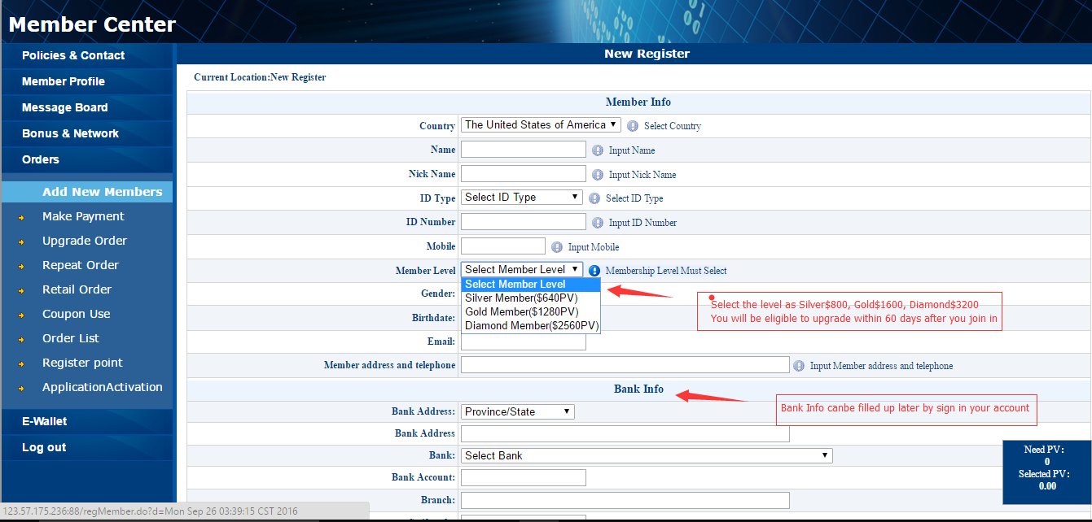
01
SIGN UP
SIGN UP BY CREATING NEW ORDERS

Slide 4
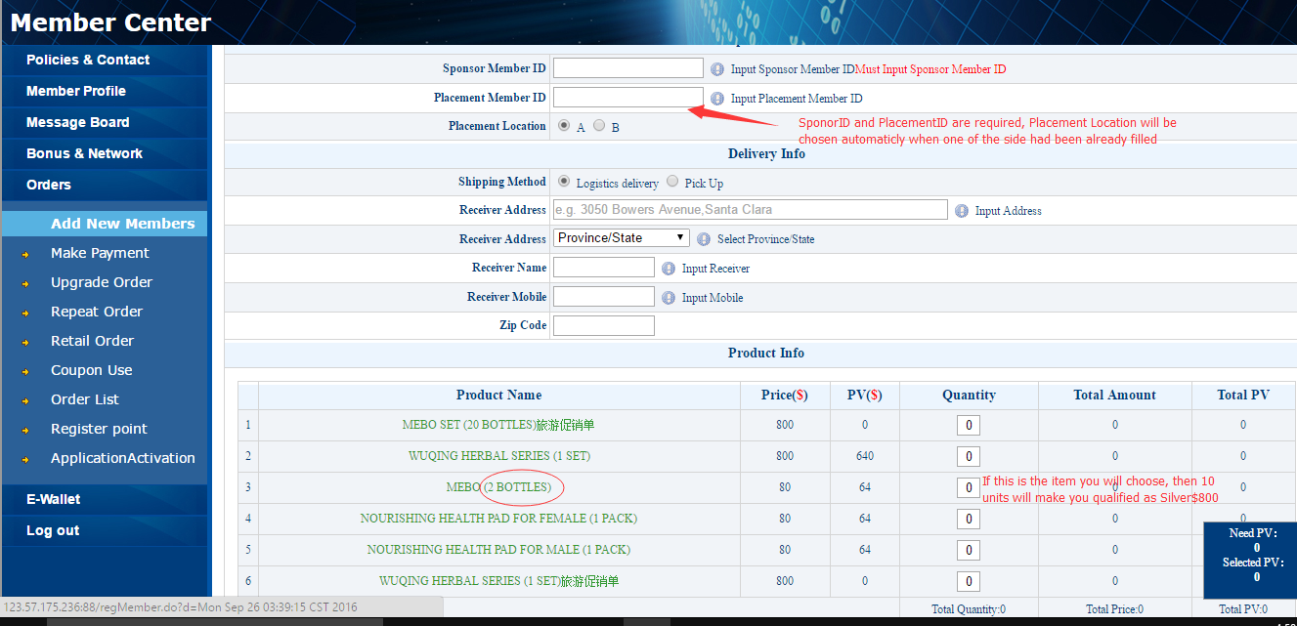
01
SIGN UP
SIGN UP BY CREATING NEW ORDERS

Slide 5
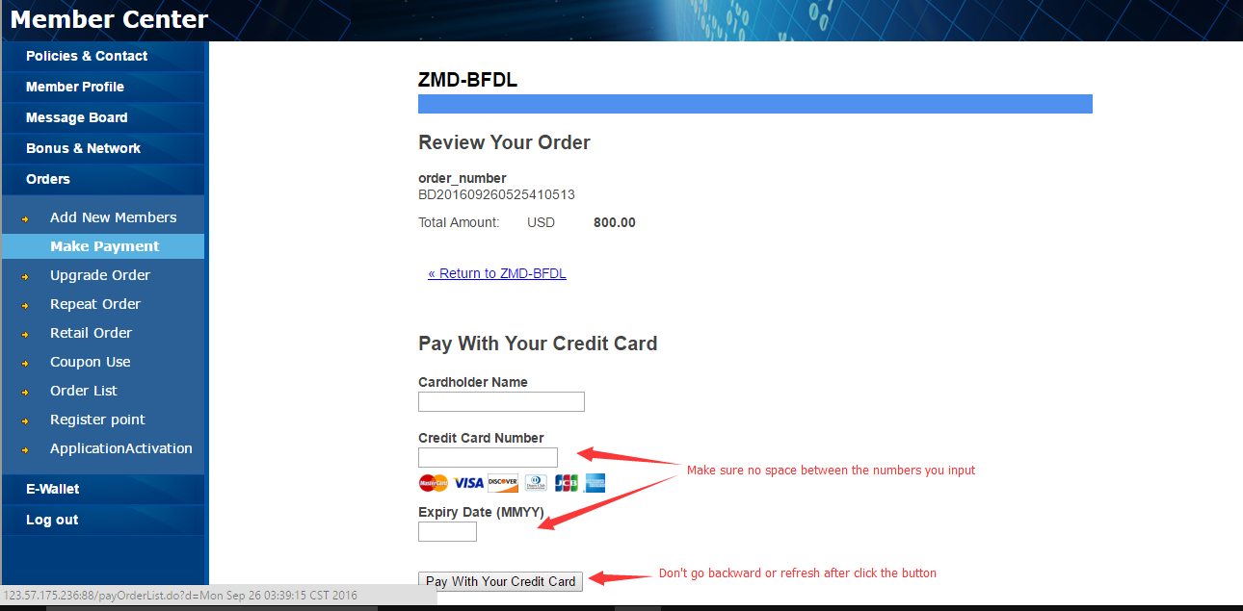
01
SIGN UP
SIGN UP BY CREATING NEW ORDERS

Slide 6
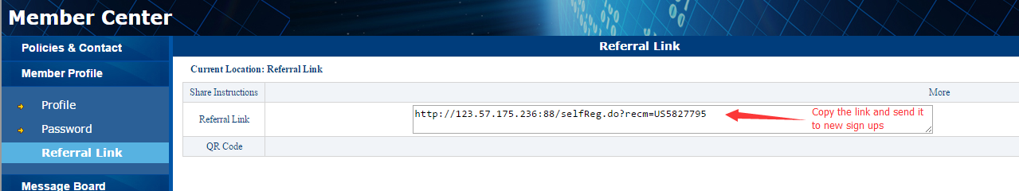
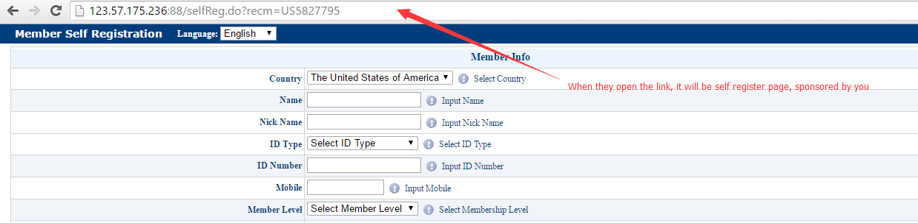
01
SIGN UP
USE REFERRAL LINK TO SIGN UP
You can also sign up people by using referral link

Slide 7
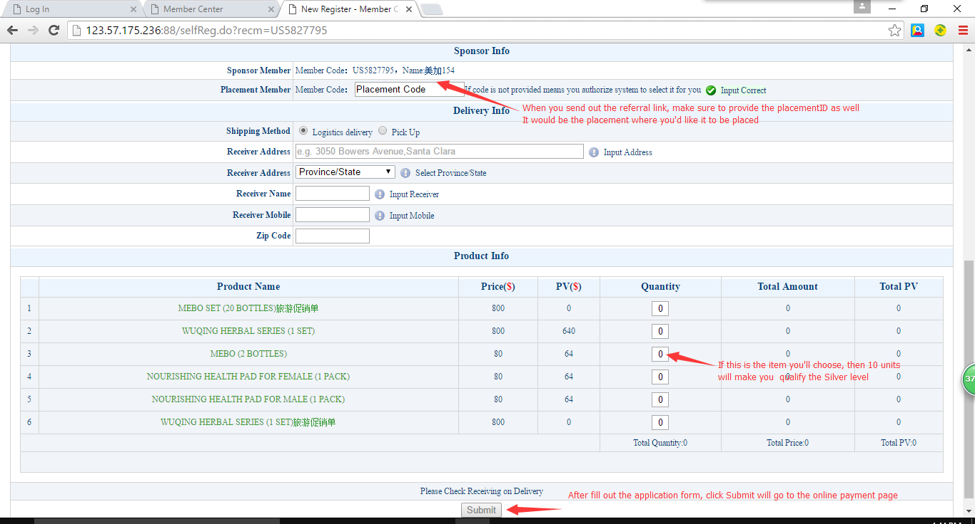
01
SIGN UP
USE REFERRAL LINK TO SIGN UP

Slide 8
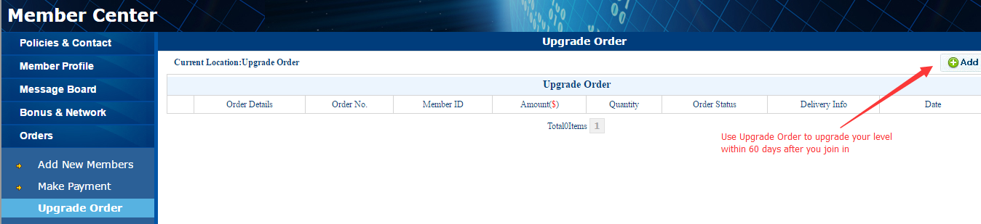
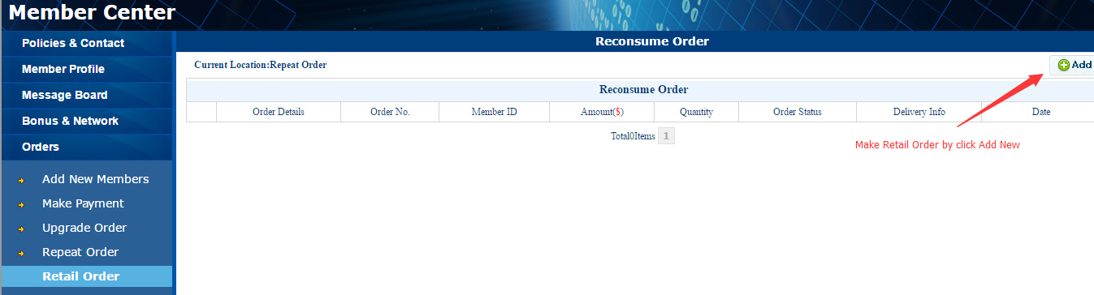
02
MAKE ORDERS
UPGRADE ORDER AND RETAIL ORDER

Slide 9
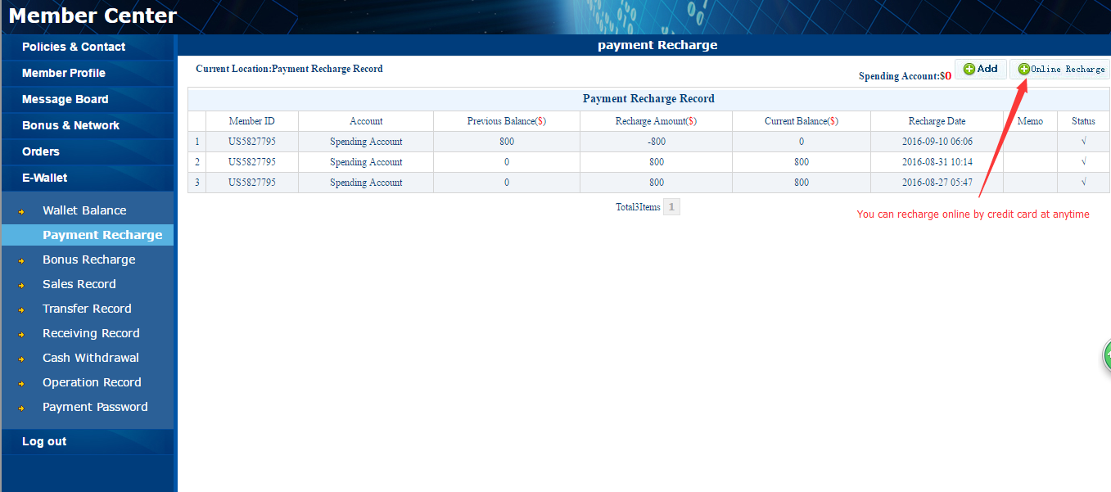
03
BONUS AND RECHARGE
RECHARGE AND WITHDRAWAL FROM BUNUS ACCOUNT

Slide 10
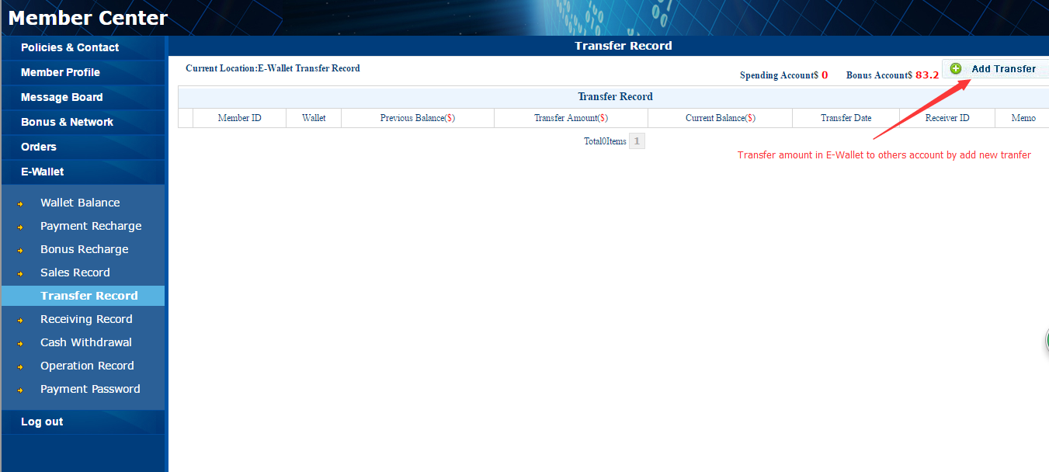
03
BONUS AND RECHARGE
RECHARGE AND WITHDRAWAL FROM BUNUS ACCOUNT

Slide 11
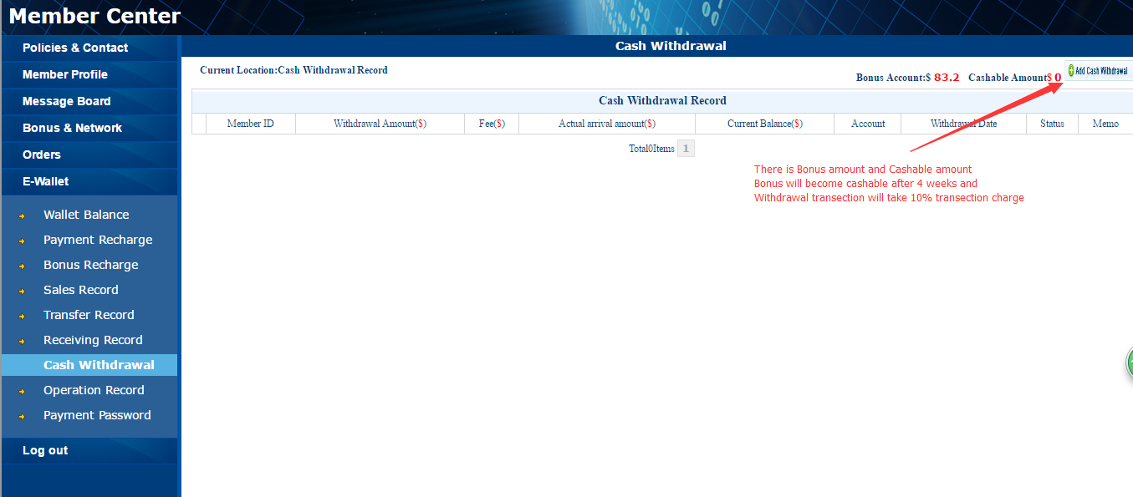
03
BONUS AND RECHARGE
RECHARGE AND WITHDRAWAL FROM BUNUS ACCOUNT

Slide 12
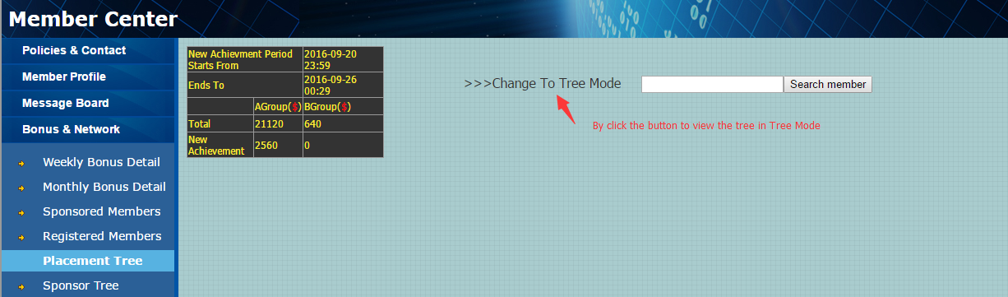
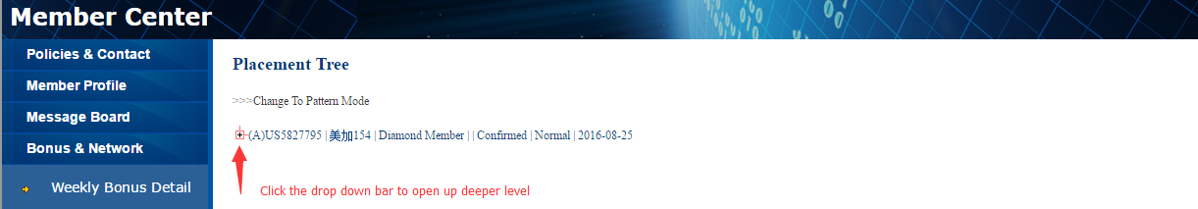
NETWORK
CHECK YOUR NETWORK AND BONUS
04

Slide 13
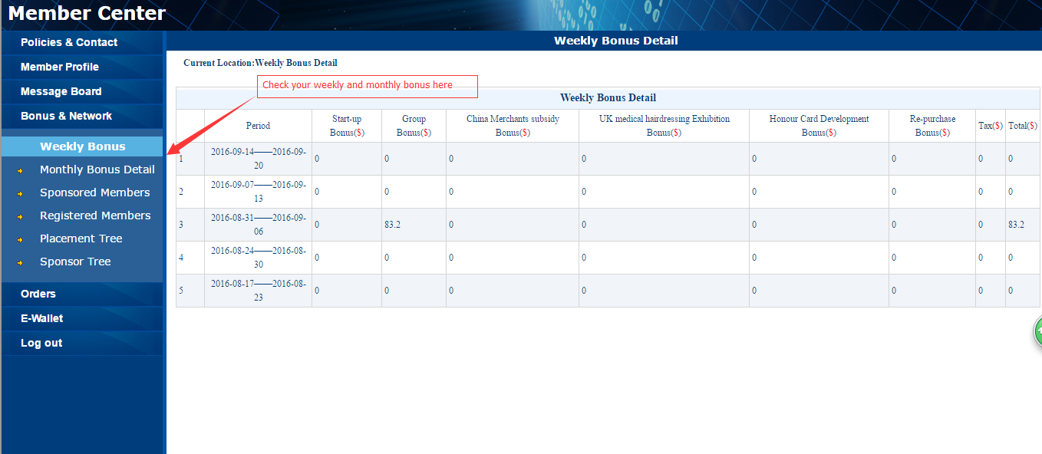
NETWORK
CHECK YOUR NETWORK AND BONUS
04

Slide 14
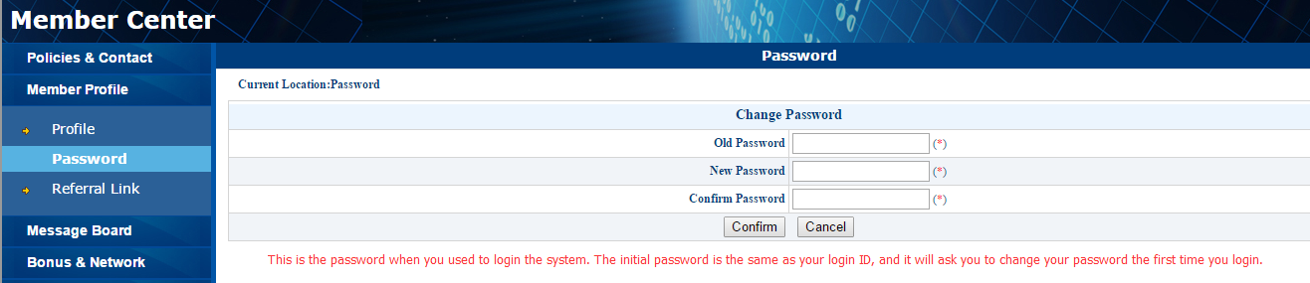
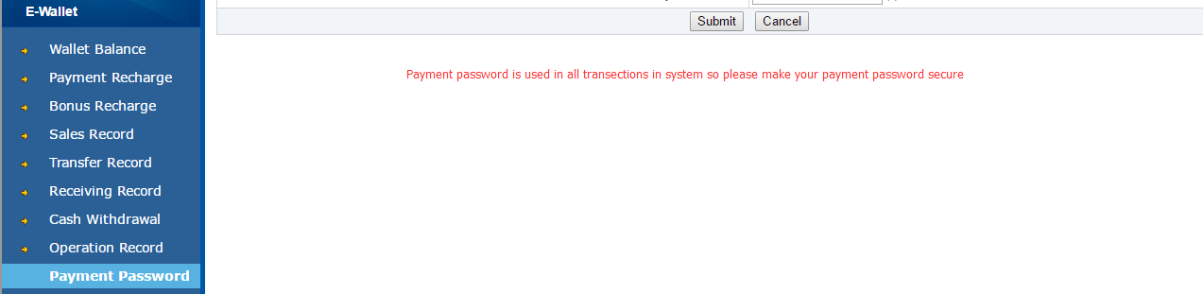
PASSWORDS
LOGIN PASSWORD AND PAYMENT PASSWORD
05

Slide 15
NORLAND

